Slide 1
Data Consulting
Salt City Data Community Presents: Data Basics Training Arc

Slide 2
Agenda
My Background
Pros & Cons
Skills
The Landscape
The Fun Part

Slide 3
My Background
BA Political Science, SUNY Buffalo State
Currently Sr Data Consultant @ CTI Data
TBR Inc (Consulting), RosieApp (Startup), Empower FCU (Finance), City of Syracuse (Public Sector)
Salt City Data Community, Syracuse WiMLDS, Ithaca College Cybersecurity Board, Syracuse University Summer College

Slide 4
Pros and cons
Autonomy
Flexibility
Defined scope
Compensation
Variety
Turnover
Travel
Hours
Lack of input
Tracking billables

Slide 5
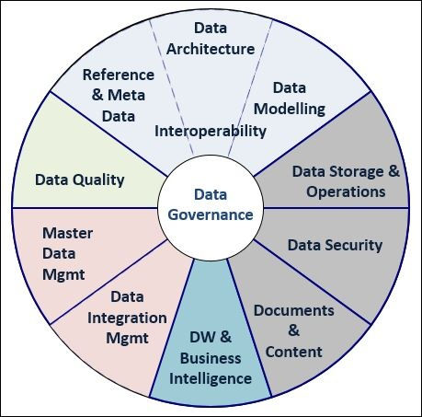
Skills
SME Knowledge
People Management
Cross Platform Technical Skills
Open Source
Full Stack v Niche

Slide 6
The Landscape
Big Four: Deloitte, EY, PwC, KPMG
Strategy Consulting: McKinsey, BCG, Bain
In House ‘Consultants’, enterprise consulting arms
Boutique Firms: Saviant, Insight Partners, CBIG Consulting

Slide 7
The fun part
I solve puzzles for a living
You don’t have to be a stats nerd
There’s a large community
High demand
Variety of skill needs
Early days of the industry

Slide 8

Questions

